Slide 1

Introduction to Python Unlocking the Power of Python
Photo by Pexels

Slide 2
01
Python: A High-Level Language
Table of Contents
02
Key Features of Python
03
Interpreted Language
04
Dynamic Typing in Python
05
Extensive Standard Library
06
Support for Multiple Paradigms
07
Community and Ecosystem
08
Popular Uses of Python
09
Getting Started with Python
10
Writing Your First Python Program
11
Conclusion

Slide 3

1
Python: A High-Level Language
Van Rossum's Creation
Python, developed by Guido van Rossum in 1991, is a high-level, interpreted language renowned for its readability, simplicity, and extensive ecosystem. Guido van Rossum created Python in 1991, emphasizing readability, simplicity, and a broad ecosystem, making it ideal for diverse applications from web development to AI. Python, introduced by Guido van Rossum in 1991, is celebrated for its readability, simplicity, and vast ecosystem, catering to applications ranging from web development to AI. Python, invented by Guido van Rossum in 1991, is beloved for its readability, simplicity, and rich ecosystem, suitable for applications from web development to AI.
Photo by Pexels

Slide 4

2
Key Features of Python
Powerful Characteristics
Python's syntax prioritizes readability, enabling developers to convey concepts concisely compared to languages like C++ or Java. Python's syntax highlights readability, allowing developers to articulate ideas with fewer lines compared to C++ or Java. Python's syntax emphasizes readability, enabling concise expression of ideas compared to C++ or Java. Python's syntax promotes readability, enabling developers to convey ideas with brevity compared to C++ or Java.
Photo by Pexels

Slide 5

3
Interpreted Language
Execution Line-by-Line
Python is an interpreted language, executing code line-by-line, aiding in debugging and development speed, although it can affect runtime performance. Being an interpreted language, Python executes code line-by-line, facilitating debugging and development speed, albeit impacting runtime performance. Python operates as an interpreted language, executing code line-by-line, assisting in debugging and development speed but influencing runtime performance. Python functions as an interpreted language, executing code line-by-line, assisting in debugging and development speed while impacting runtime performance.
Photo by Pexels

Slide 6

4
Dynamic Typing in Python
Flexible Coding
Python employs dynamic typing, determining types at runtime, which offers coding flexibility but requires careful management to avoid runtime errors. With dynamic typing, Python identifies types at runtime, providing coding flexibility but necessitating prudent handling to prevent runtime errors. Dynamic typing in Python ascertains types at runtime, allowing coding flexibility but demanding cautious management to prevent runtime errors. In Python, dynamic typing discovers types at runtime, enabling coding flexibility but necessitating careful handling to prevent runtime errors.
Photo by Pexels

Slide 7

5
Extensive Standard Library
Versatile Tool Support
Python's standard library facilitates common programming tasks such as file I/O and system calls, reducing reliance on external libraries for many functions. The rich standard library of Python aids in tasks like file I/O and system calls, diminishing the need for external libraries in numerous operations. Python's standard library supports tasks like file I/O and system calls, diminishing the dependency on external libraries for various functions. With a comprehensive standard library, Python encompasses functions like file I/O and system calls, minimizing the requirement for external libraries.
Photo by Pexels

Slide 8

6
Support for Multiple Paradigms
Versatility Unleashed
Python supports procedural, object-oriented, and functional programming paradigms, making it a versatile tool suitable for diverse project types. Supporting procedural, object-oriented, and functional programming paradigms, Python emerges as a versatile tool adaptable to different project requirements. Embracing procedural, object-oriented, and functional programming paradigms, Python stands out as a versatile tool adaptable to various project scopes. With support for procedural, object-oriented, and functional programming paradigms, Python shines as a versatile tool suitable for different project contexts.
Photo by Pexels

Slide 9

7
Community and Ecosystem
Enriched by Collaboration
Python's vibrant community and vast ecosystem of third-party packages enhance its functionality and usability, supported by the Python Package Index (PyPI) hosting thousands of extensions. Empowered by an active community and extensive ecosystem, Python thrives with third-party packages, bolstered by PyPI that hosts thousands of extensions. Benefiting from a dynamic community and expansive ecosystem, Python excels with third-party packages, backed by PyPI hosting numerous extensions. Thriving on a lively community and vast ecosystem, Python excels with third-party packages, fortified by PyPI hosting a multitude of extensions.
Photo by Pexels

Slide 10
8
Popular Uses of Python
Diverse Applications
Python finds favor in data science for its libraries like NumPy, pandas, and Matplotlib, offering robust tools for data analysis, manipulation, and visualization. In data science, Python reigns supreme with libraries like NumPy, pandas, and Matplotlib, providing powerful tools for data analysis, manipulation, and visualization. Data science embraces Python for its libraries like NumPy, pandas, and Matplotlib, offering potent tools for data analysis, manipulation, and visualization. Python is the go-to in data science with its libraries like NumPy, pandas, and Matplotlib, delivering robust tools for data analysis, manipulation, and visualization.
Photo by Pexels

Slide 11
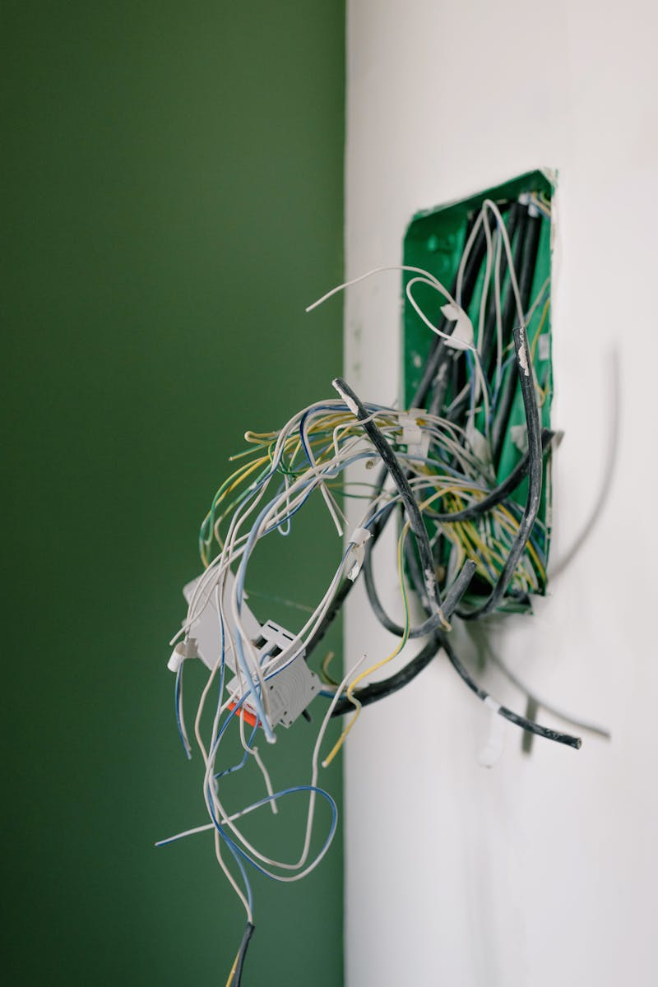
9
Getting Started with Python
Embarking on a Python Journey
To begin with Python, download it from the official website and follow installation instructions available for Windows, macOS, and Linux. The journey with Python starts by downloading it from the official website and installing it on Windows, macOS, or Linux following the provided instructions. Starting with Python involves downloading it from the official website and installing it on Windows, macOS, or Linux based on the available instructions. Embarking on Python requires downloading it from the official website and installing it on Windows, macOS, or Linux following the installation guidelines.
Photo by Pexels

Slide 12

10
Your First Python Program
Hello, Python!
To write your first Python program, open a text editor or IDE, type the code 'print("Hello, Python!")', save it with a .py extension, and run it from the command line using 'python your_program.py'. Begin your Python journey by writing your first program; open a text editor or IDE, input 'print("Hello, Python!")', save with a .py extension, and run using 'python your_program.py'. Start your Python experience by creating your initial program; use a text editor or IDE, type 'print("Hello, Python!")', save as a .py file, and execute with 'python your_program.py'. Kickstart your Python venture with your first program; open a text editor or IDE, write 'print("Hello, Python!")', save as .py, and run via 'python your_program.py'.
Photo by Pexels

Slide 13

11
Conclusion
Python's Versatility
Python's blend of simplicity, readability, and a robust standard library makes it an excellent choice for developers of all levels, powering various domains like web development, data science, and AI. The simplicity, readability, and extensive standard library of Python position it as a top choice for developers, driving innovations in web development, data science, and AI. With simplicity, readability, and a powerful library, Python emerges as a prime pick for developers, enabling advancements in web development, data science, and AI. By harmonizing simplicity, readability, and a comprehensive standard library, Python emerges as a top-notch choice for developers, fueling progress in web development, data science, and AI.
Photo by Pexels

